Slide 1
Xamarin

Slide 2
Agenda
What is Xamarin?
Features
Approaches in developing apps
VS usage
Overview of components
Demo

Slide 3
What is Xamarin?

Slide 4
An open source app platform
from Microsoft for
building modern & performant
iOS, Android, macOS,
watchOS, & tvOS apps with .NET.

Slide 5
Advantages of Xamarin

Slide 6
Features
Access to C# - NET API
Shared code base – about 90%
Native API Access
Less maintenance
Time/Cost
Supports MVVM
High performance
WORA – Write once run anywhere

Slide 7
Approaches of building Application using Xamarin

Slide 8

Xamarin + Xamarin.Forms
iOS C# UI
Android C# UI
Windows C# UI
Shared UI Code
Shared C# Backend
Shared C# Backend
Traditional Xamarin Approach
With Xamarin.Forms: More code-sharing, all native

Slide 9
Visual studio : IDE used for Xamarin Development

Slide 10

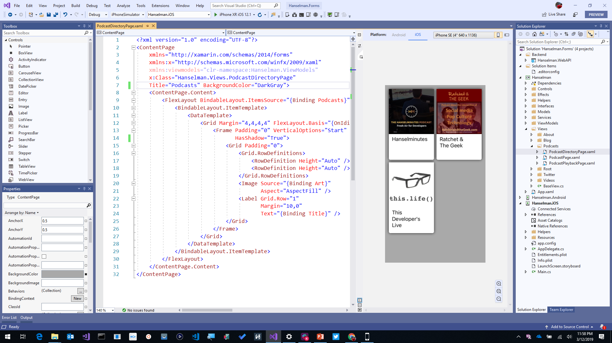
Visual Studio 2019
iOS, Android, Desktop, Web, Cloud, and More!
Advanced IntelliSense & Code Cleanup
Enhanced Collaboration with Live Share and Pull Request Experience
Advanced Debugger & Search Windows
Simple Connected Services to Deploy to Azure

Slide 11

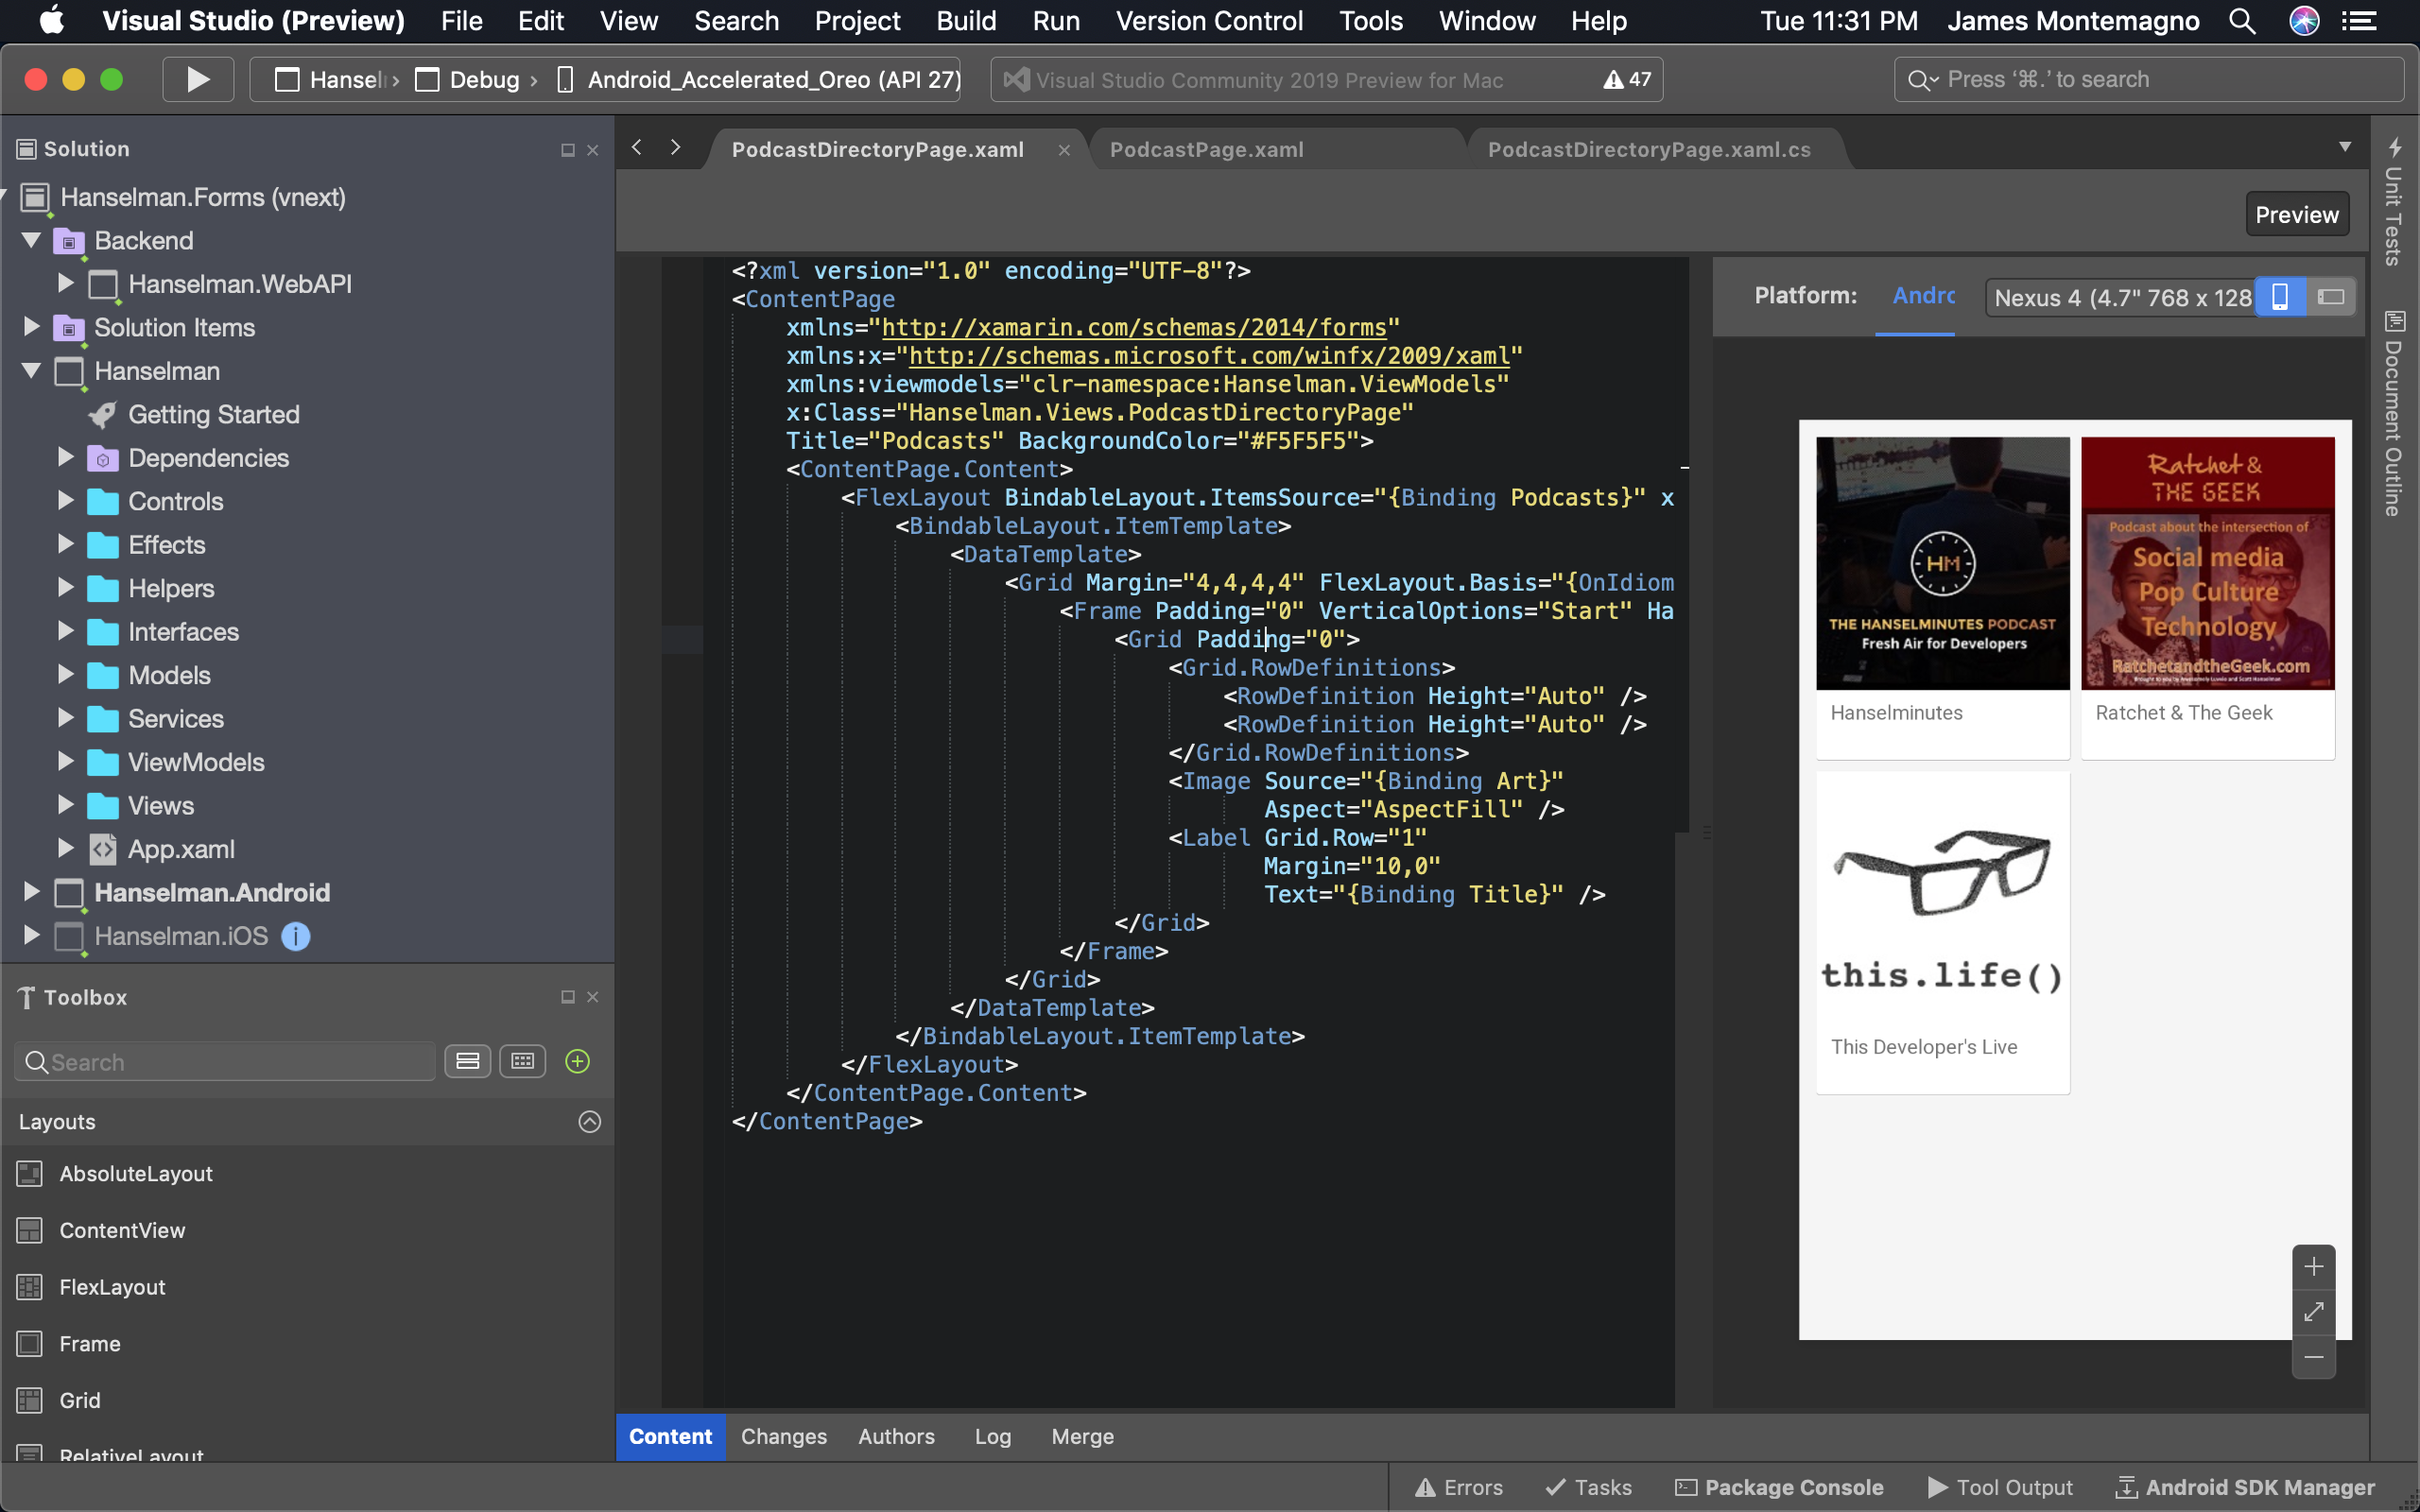
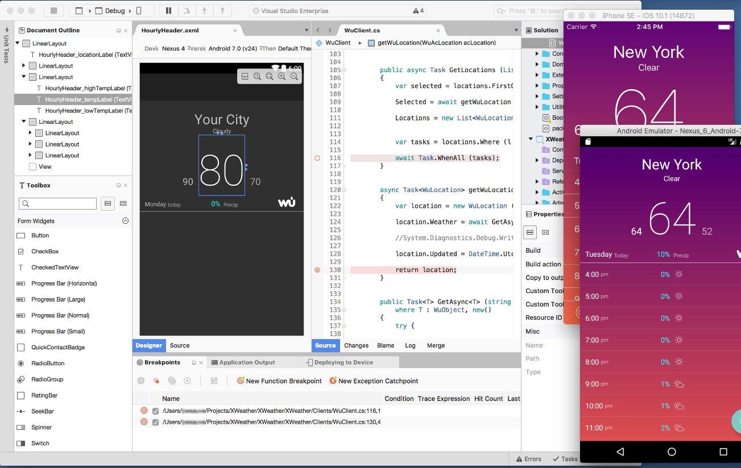
Visual Studio 2019 for Mac
.NET Centric
Focused on .NET Developers
.NET Core
ASP.NET Core Web Apps & APIs
Unity
Develop and Debug Unity Game Code
Xamarin
Mobile: Android, iOS, watchOS
macOS, tvOS
Azure
Connected Services
Easy Deployment
Azure Functions

Slide 12

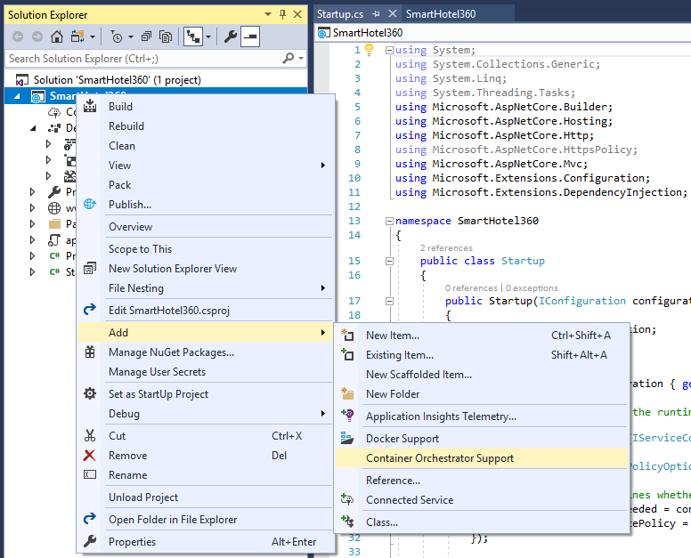
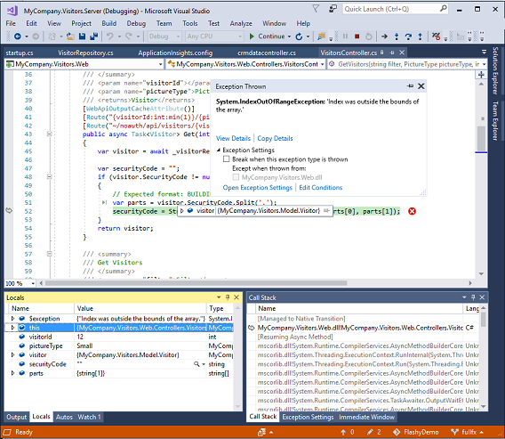
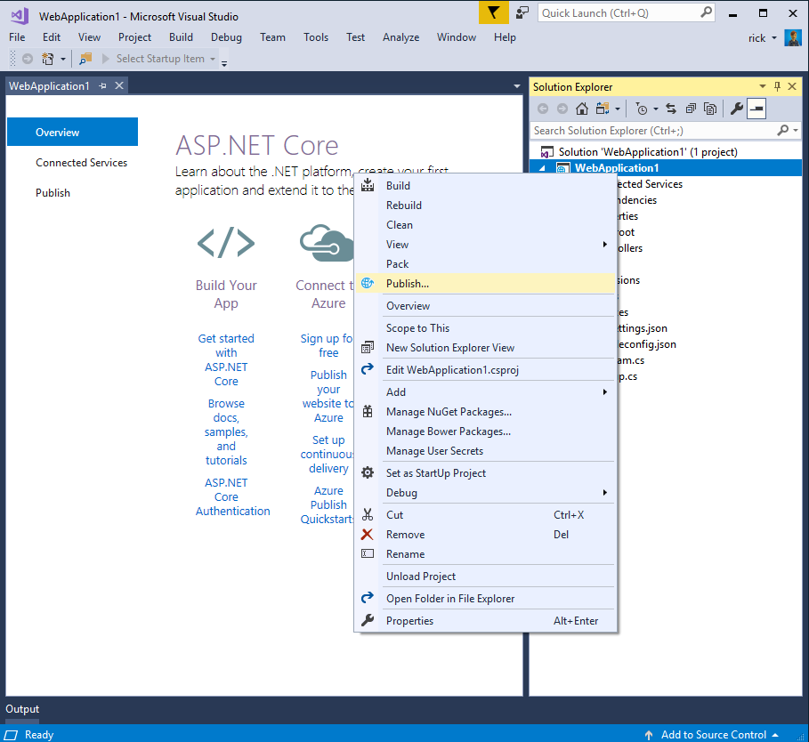
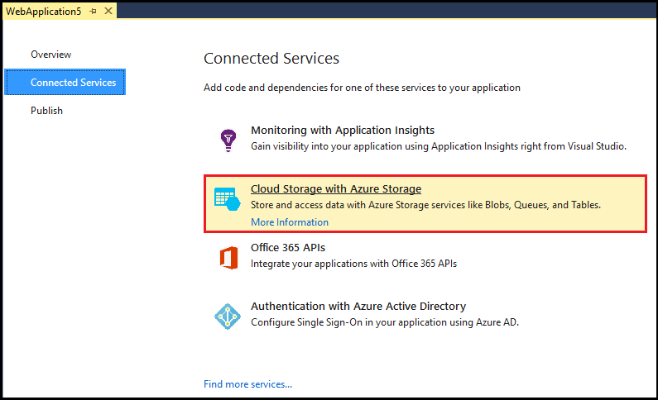
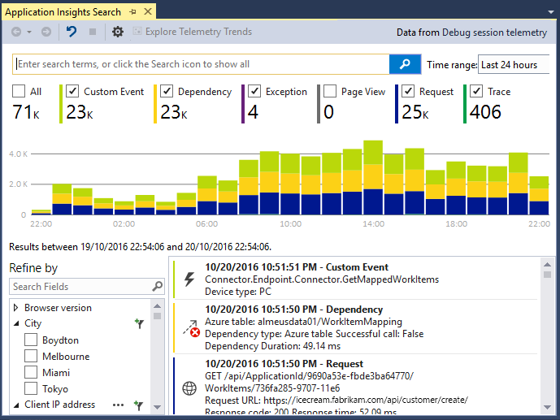
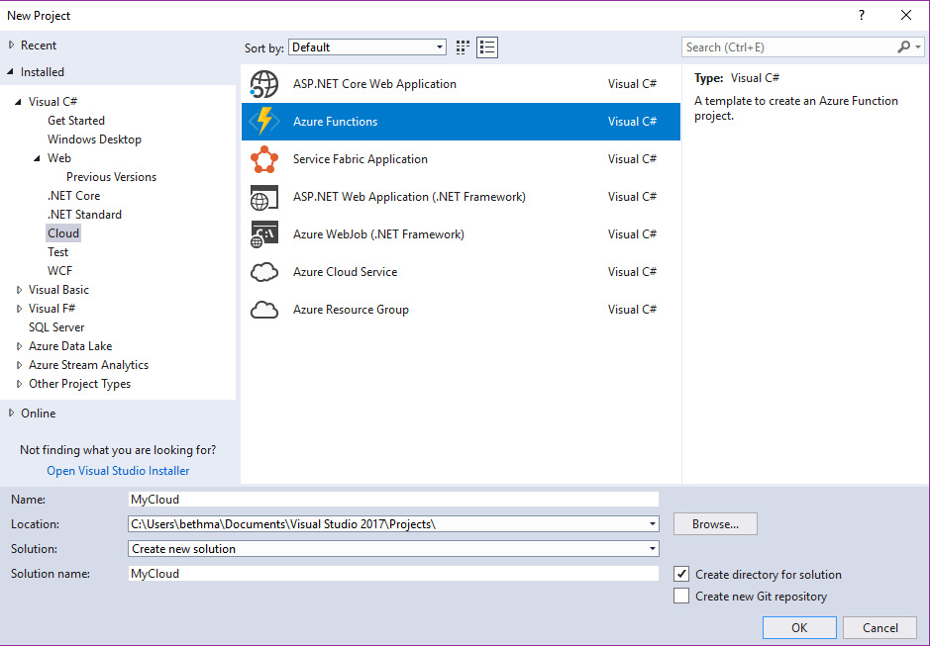
Accelerate your
development
cloud
Seamless Azure Integration
Publish directly to Azure without leaving the IDE
Connected Services
A new experience for easily discovering and extending your app with cloud services
Container Tools
Quickly add Docker compose and container orchestrator support to your apps
App Insights with Code Lens
Get a 360° view of your app that includes availability, performance and user behavior
Azure Functions
Get started quickly with serverless using templates and tools for development and debugging
Snapshot Debugging
Production debugging your cloud apps has never been so simple

Slide 13
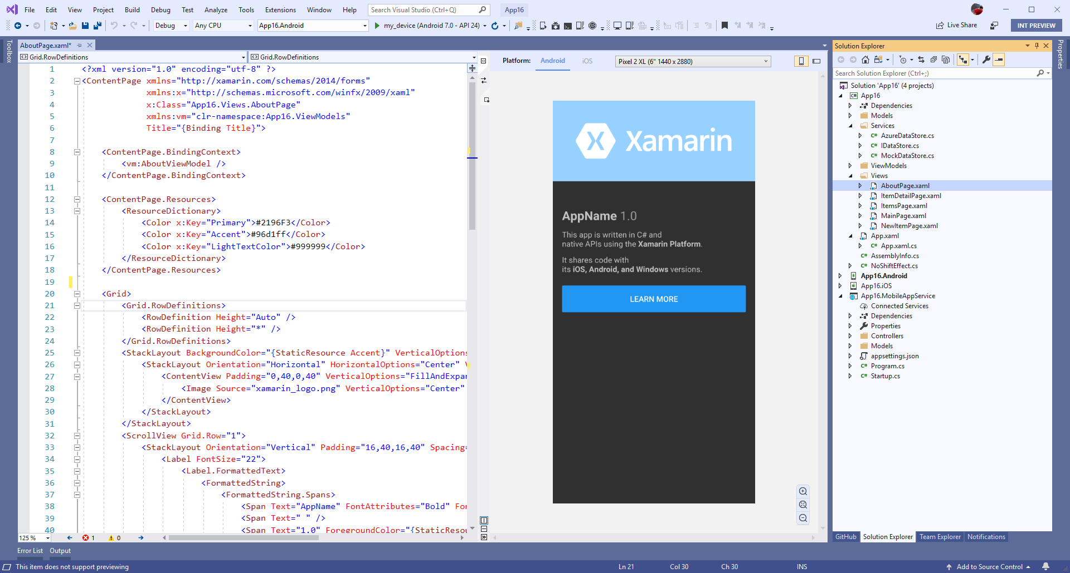
Xamarin.Forms Previewer
Quickly preview a visualization of your user interface
Drag & Drop Controls to XAML and modify in property panel
Target multiple screen sizes and resolutions of iOS & Android devices.
Preview data with design time attributes

Slide 14
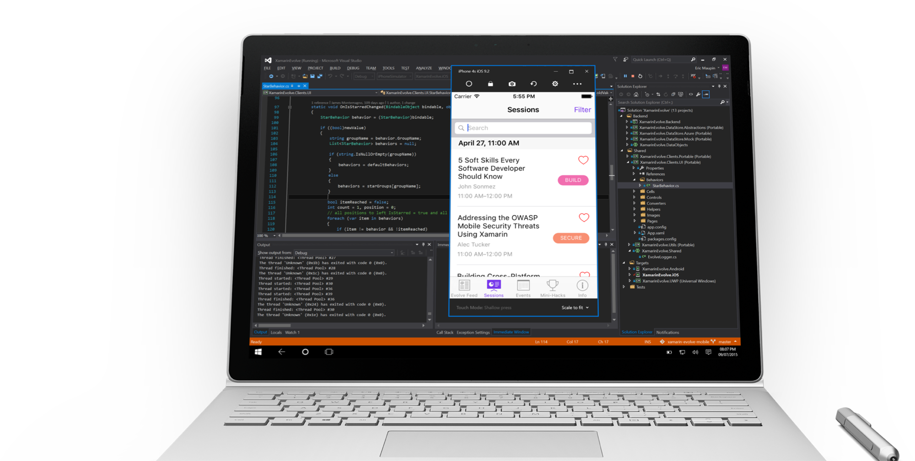
Visual Studio iOS Simulator Remoting
Multi-Touch Enabled
Pressure Sensitive
Super Fast
Rotate, screenshots, location changes
Never leave VS

Slide 15
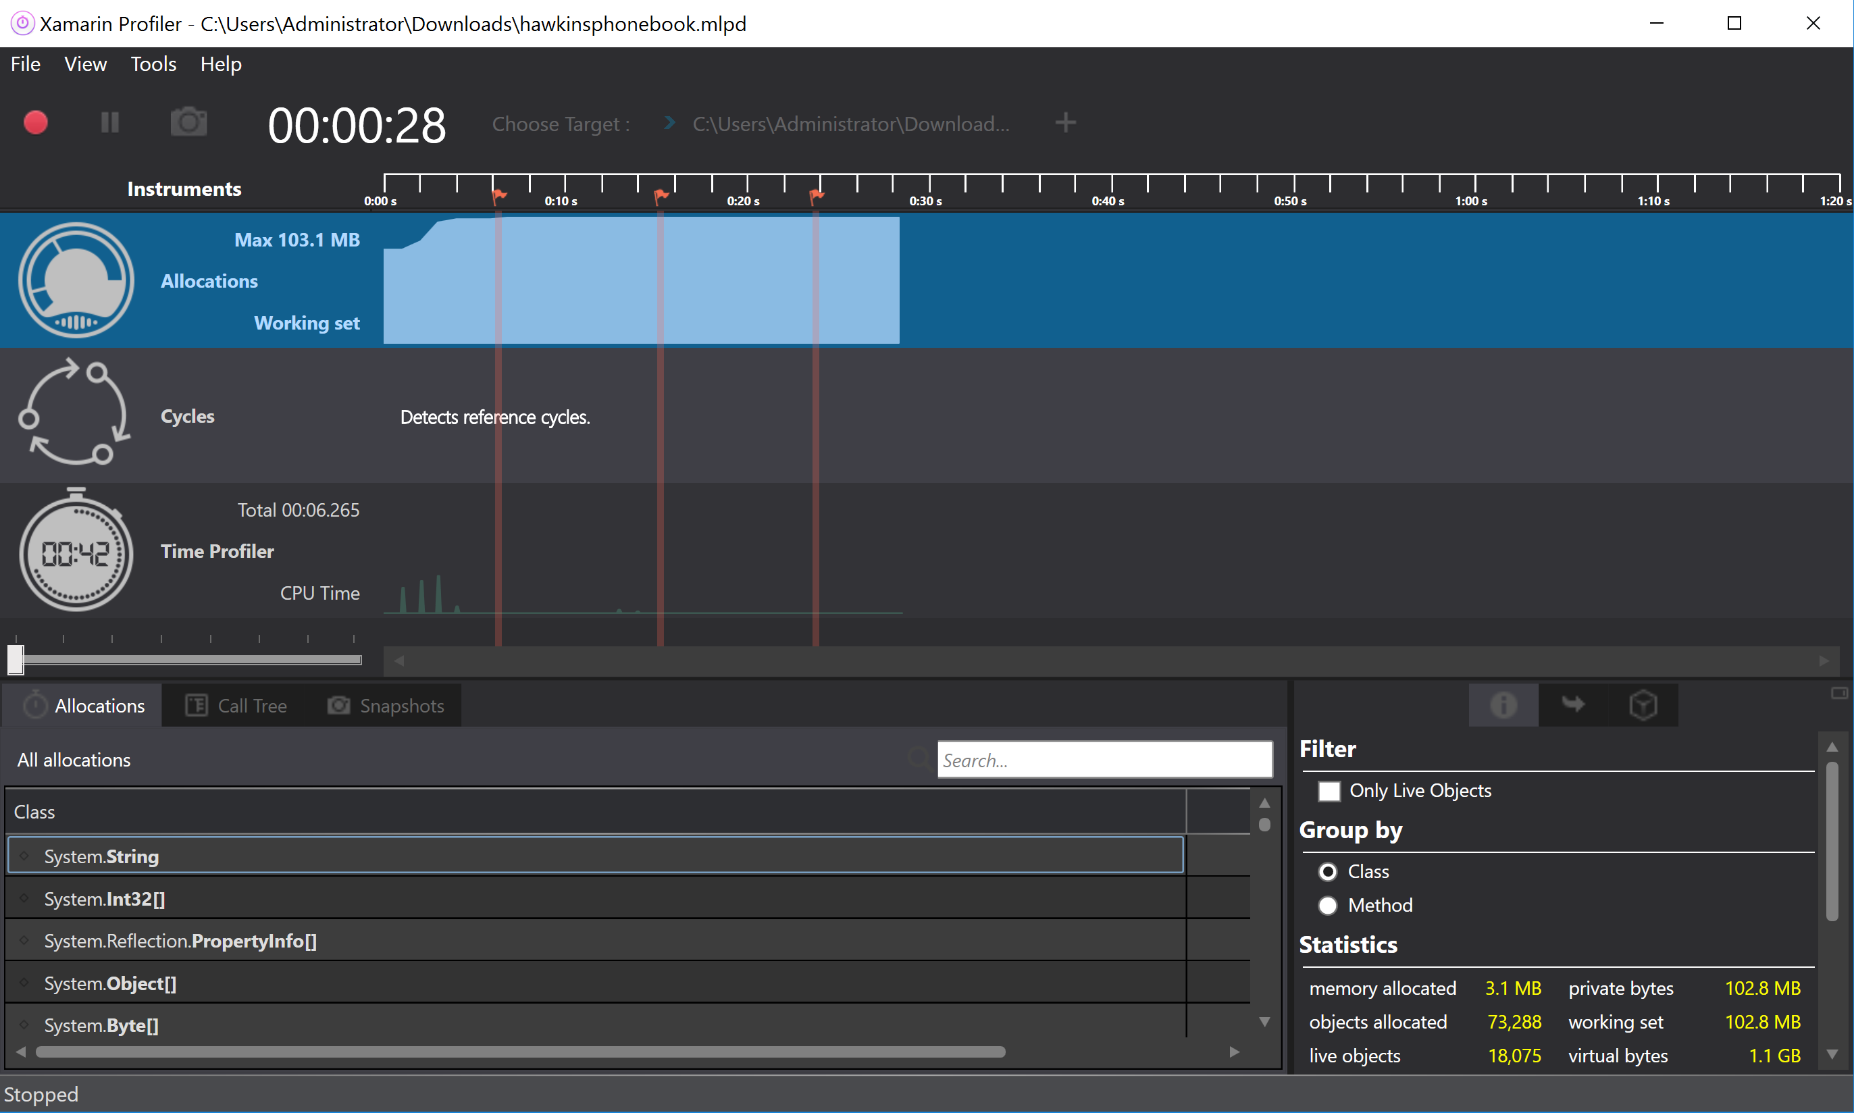
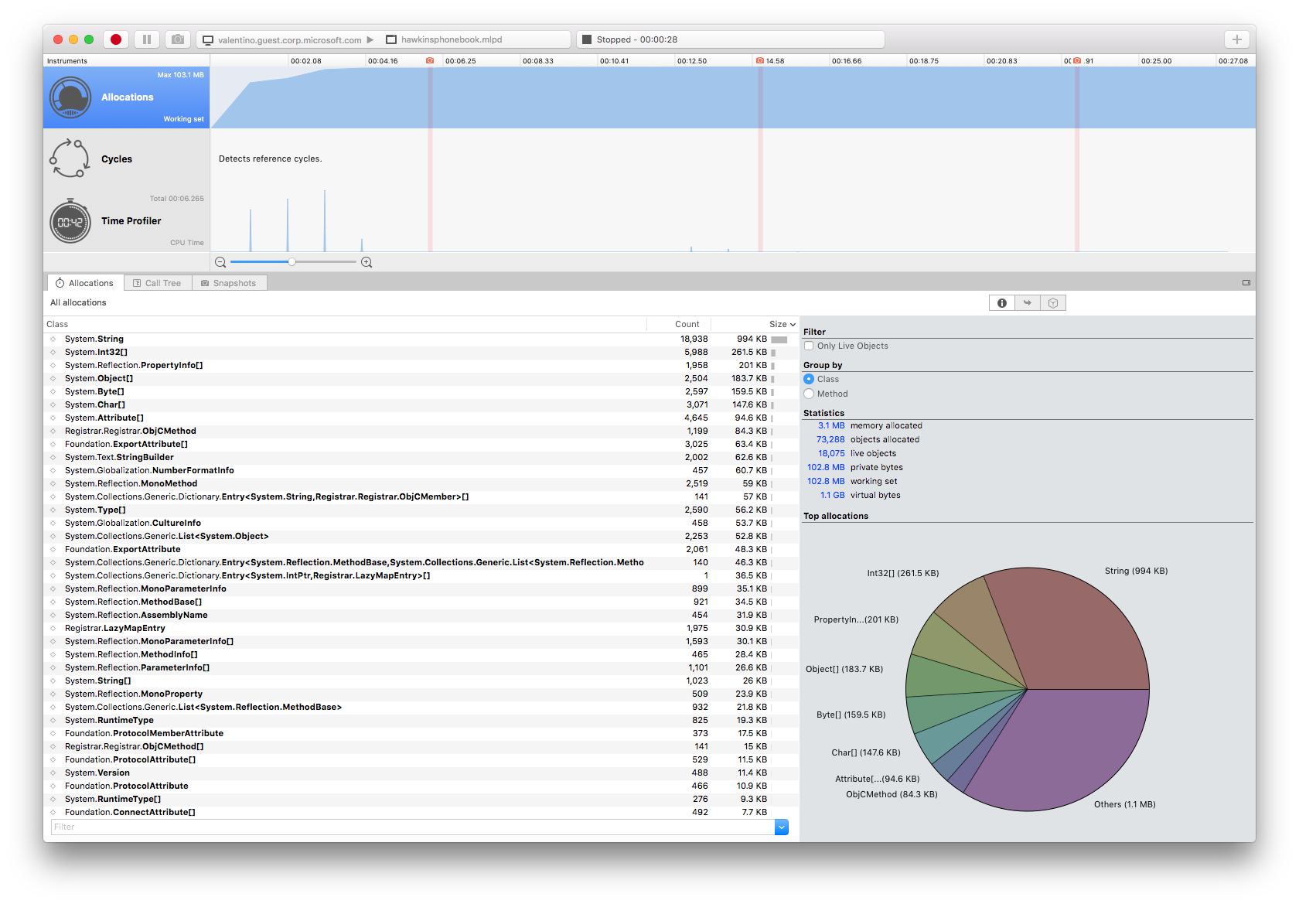
Xamarin Profiler
Analyze & Polish Apps
Key Instruments:
Allocations
Time Profiler
Cycles
Snapshots & More
*Enterprise

Slide 16
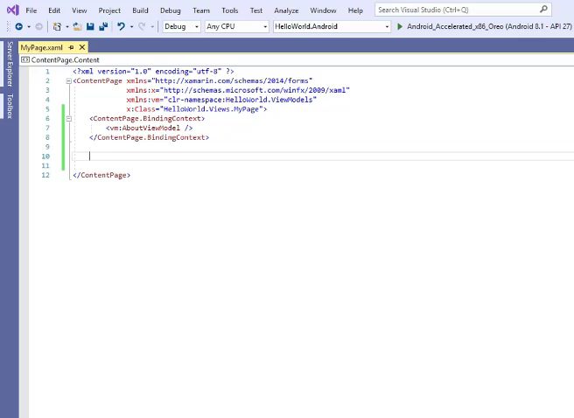

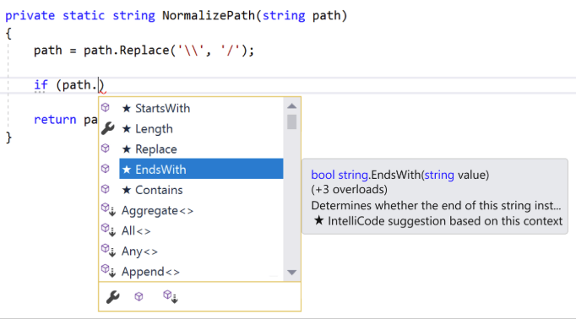
IntelliCode Support for C# & XAML
Assisted IntelliSense for C# & XAML
*VS 2019

Slide 17
Xamarin.Forms Overview

Slide 18
What’s included
.NET
✓ 40+ Pages, layouts, and controls
(Build from C# or XAML)
✓ Two-way data binding
✓ Navigation
✓ Visual State Manager
✓ Animation API
✓ Dependency Service
✓ Messaging Center
C#
C#
C#
Xamarin.Forms - UI
Xamarin.Essentials
Shared C#
Business Logic

Slide 19
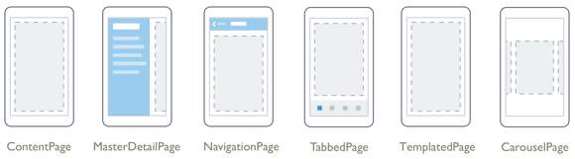
Pages

Slide 20
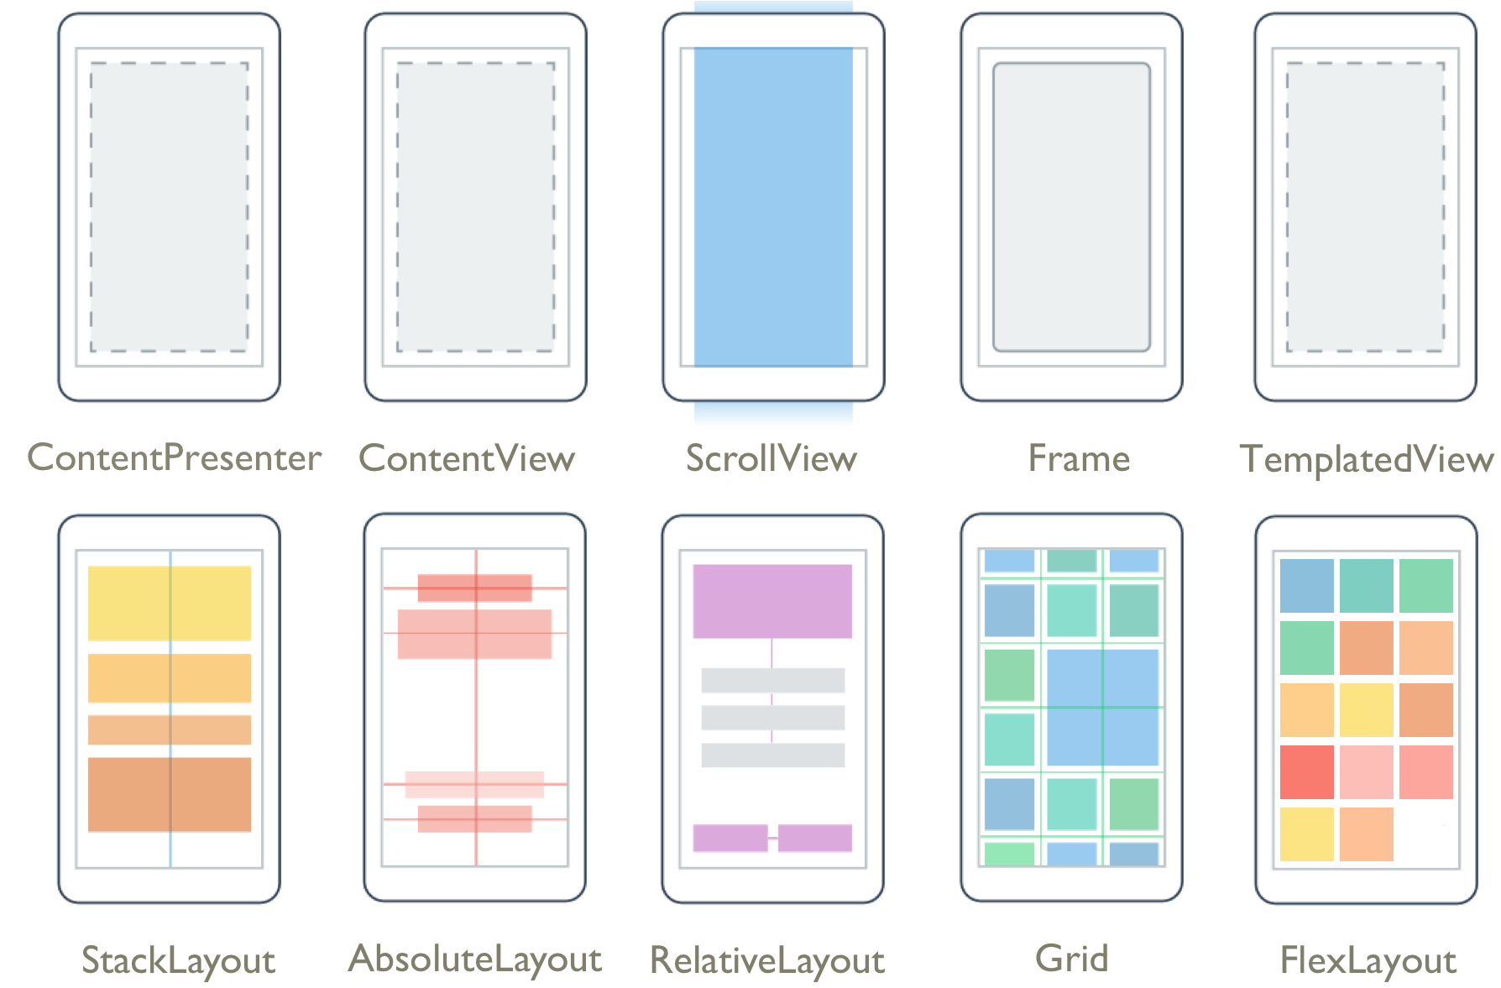
Layouts

Slide 21
Controls
ActivityIndicator
BoxView
Button
DatePicker
Editor
Entry
Image
Label
TextCell
ImageButton
ViewCell
Picker
ProgressBar
SearchBar
Slider
Stepper
TimePicker
ListView
WebView
EntryCell
ImageCell
SwitchCell

Slide 22
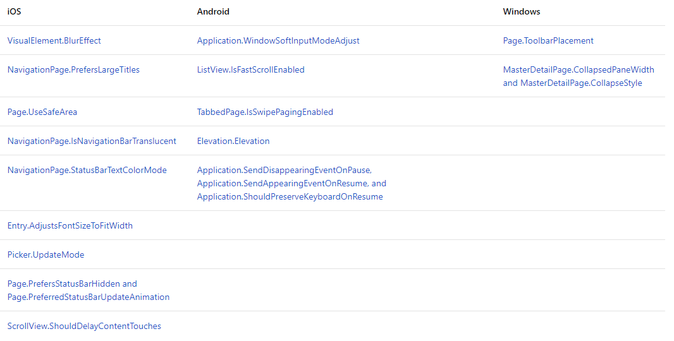
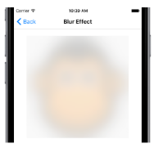
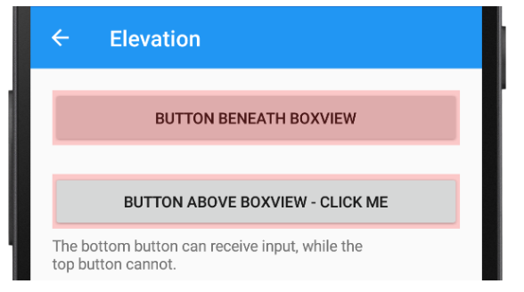
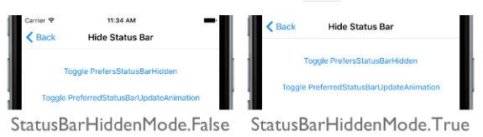
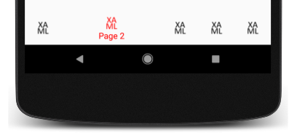
Platform Specifics
Built-in UI Tweaks

Slide 23
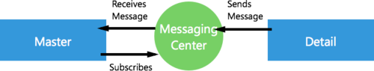
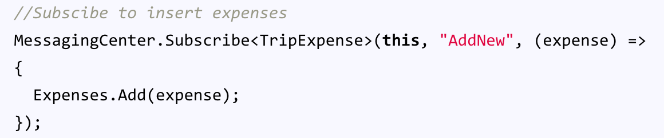
Messaging Center
Master Page:
Detail Page:

Slide 24
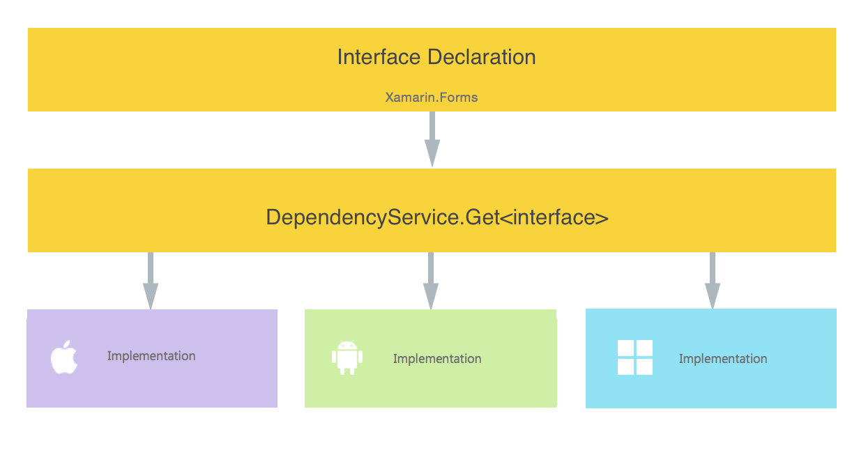
Dependency Service
Access Native Features Easily

Slide 25
Thank you
Sivaram ganesan
Technology analyst, Infosys
Ganesan.Sivaram@gmail.com
https://xmonkeys360.com/
@xamarinmonkeys

